Slide 1

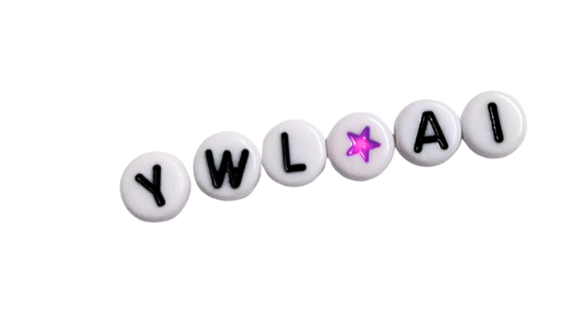
YOUNG WOMEN’S GUIDE TO AI
Welcome to our workshop

Slide 2


Icebreaker: Firsts
Firsts List:
  First time I found out about AI
  First time I used AI
  First reaction/thoughts to using AI
  First AI video I watched

Slide 3
Young Women’s Guide to AI
https://youngwomenscot.org/guide-to-ai/

Slide 4
Our Demands
Three key groups emerged as the focus for our demands:
  The Government
  The technology industry
  The general public
We believe that targeting these groups offers the greatest potential for meaningful impact.

Slide 5
Our Demands
The Government
Government policy must protect young women and girls from the harms of AI by ensuring that there are stricter rules and repercussions for both the creation and sharing of non-consensual intimate images.
Policies must be trauma-informed, taking victim experience into account, and flexible in their approach, to reflect the fast-paced nature of technological advancements in this area.

Slide 6
Our Demands
The Tech Sector
Technology creators must be held responsible for ensuring that robust safety measures are included in the building of AI systems and guarantee the inclusion of efficient and effective reporting methods.
Technology platforms must prioritise the safety of their young women and girl users by taking accountability for harmful content, committing to the removal of NCII and promoting a culture of care.

Slide 7
Our Demands
The General Public
We, the general public, must not be blind to the harms of AI on young women, girls, and others. We must ensure that children and young people have a comprehensive understanding of AI and are taught to think critically about these systems.
We must also demand a change in culture by providing preventative education on NCII, ensuring that perpetrators face appropriate consequences and that victims are supported to not feel alone.

Slide 8
Cycle of Harm
  The ‘Cycle of Harm’ chart was created by our previous YWL co-hort of 2025 and developed to explain why gender based violence keeps happening and how each part of the problem feeds into the next.
  It breaks the issue into seven stages and shows where action is most needed to break the cycle.

Slide 9
Cycle of Harm Activity
In small groups,
  place the cycle of harm sections in the order you think they go

Slide 10
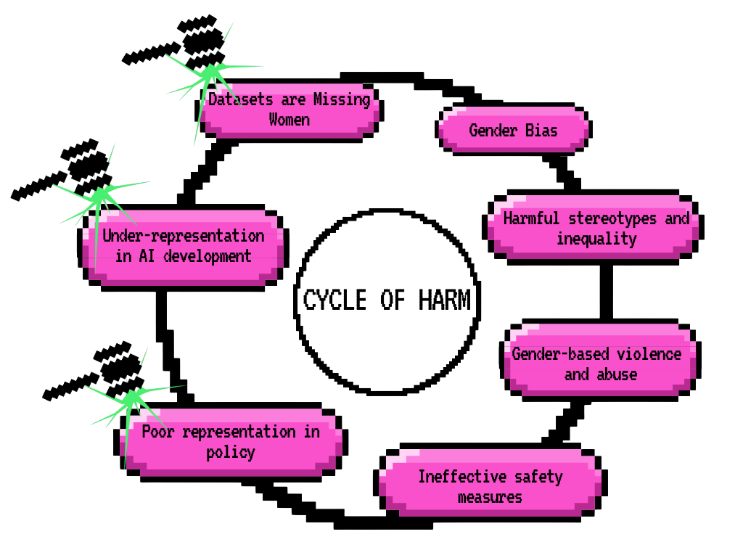
Cycle of Harm

Slide 11
Safety Guidelines Activity
In small groups, create a mind map for the following:
  What Safety guidelines would you introduce/would like to see introduced to eradicate VAWG in the AI space.

Slide 12
What happens with the information?
  The information you have come up with around safety guidelines is valued and appreciated
  It will feed into wider conversations the YWM team take forward in decision making spaces to ensure young women’s needs are represented
  Information will be included in appropriate research, reports and funding applications
  Your voices will be centred in conversations about AI safety that we are taking forward.

Slide 13
Evaluation
Using the 3 different coloured post it notes provided, answer each of the following:
  What will you take away from this workshop?
  Rate the workshop on scale of 1-10 (1 being the lowest and 10 being the highest)
  Write one word to sum up how you feel about AI

Slide 14
Thank You!
We hope you enjoyed our workshop. Please check out our Young Women’s Guide to AI on our website
for more information and guidance.

