Slide 1

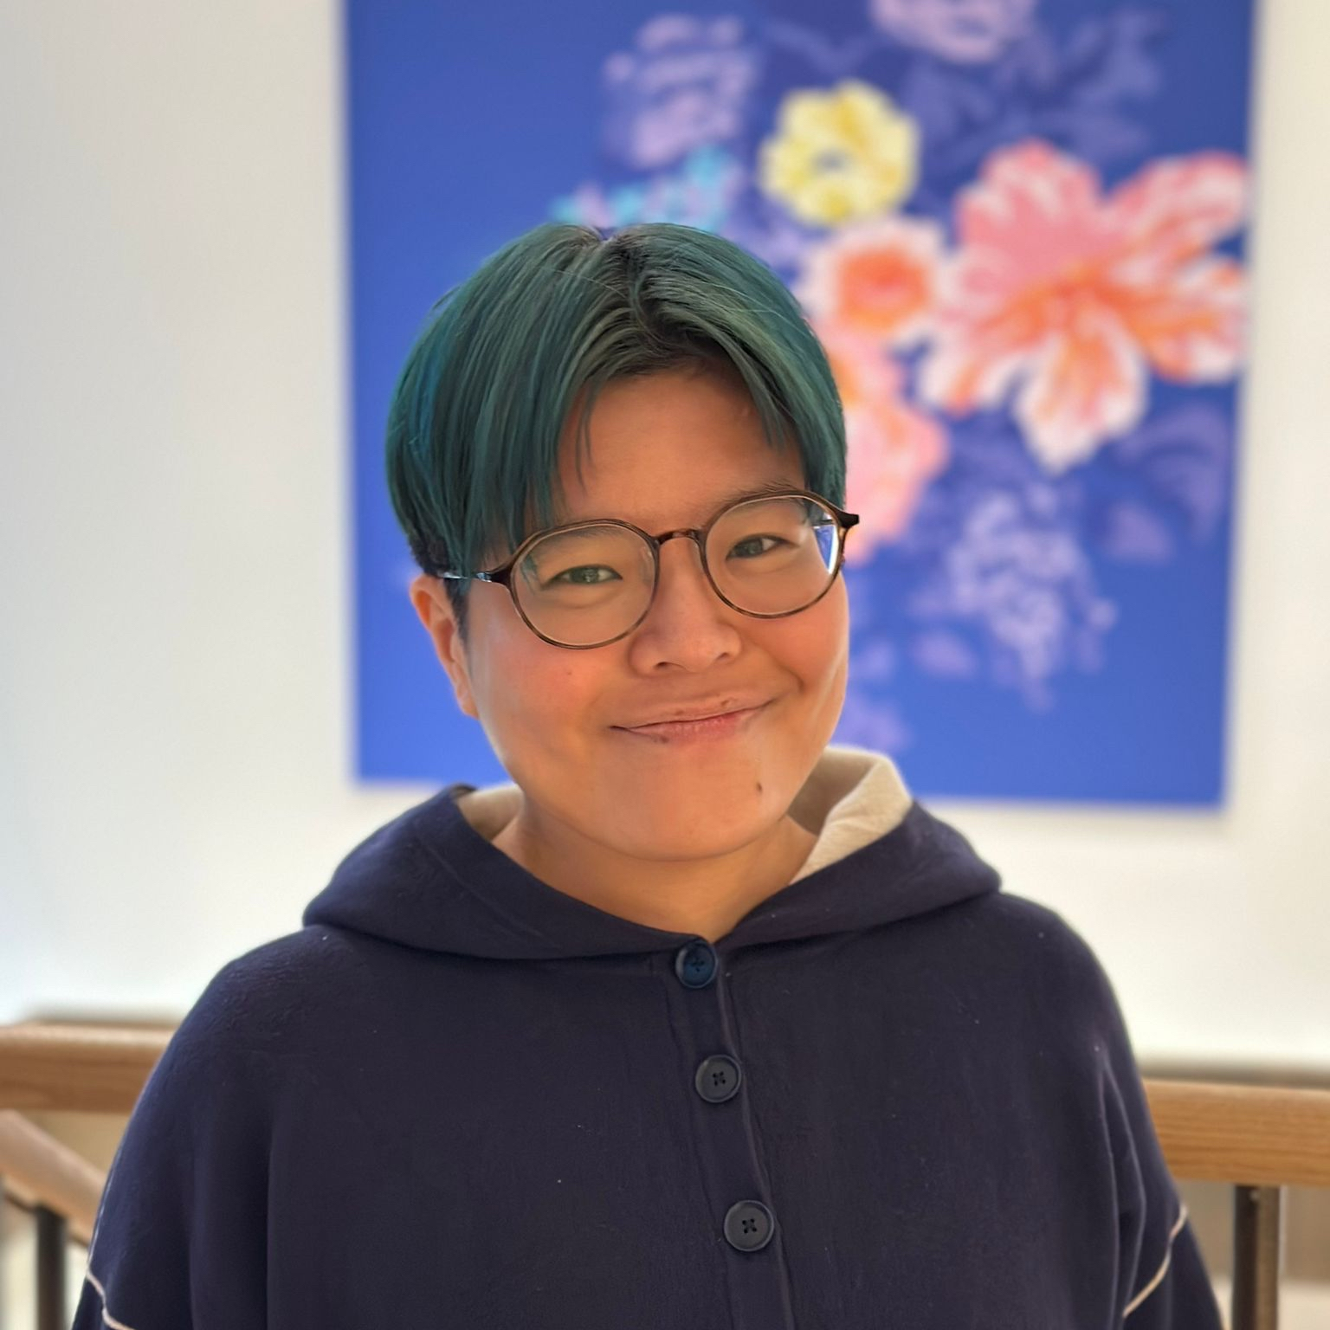

WHEN AI PLATFORMS SEXUALISE WOMEN:
Evidence, Accountability, and What Comes Next
Risa Kawamura (they/them)
Partnerships Officer
Laura Kaun (she/her)
Head of Public Affairs
Notes:
Introduce ourselves
Thank you for joining us today

Slide 2

BEFORE WE START
This session will last 45 minutes (presentation + discussion)
We will share the slides after the session
If you have any questions at any point, please don't hesitate to ask
Feel free to leave the room if you start feeling uncomfortable

Slide 3

WE FIGHT FOR
Human rights and civil liberties in the digital world
WE RESEARCH ONLINE HARMS
Holding social media accountable for their failures
Proposing policy solutions to fix problems
Working with governments to enforce action
WE ADVOCATE FOR CHANGE
We collaborate with charities, the media, politicians, celebrities, and parents
We convene with events and resources

Slide 4
AGENDA
EVIDENCE | What’s regulated by Online Safety Act CCDH research spotlight: How gendered harm is built into AI
DISCUSSION | What should accountability look like?
CALL FOR ACTION | Key takeaways of the workshop and next steps

Slide 5
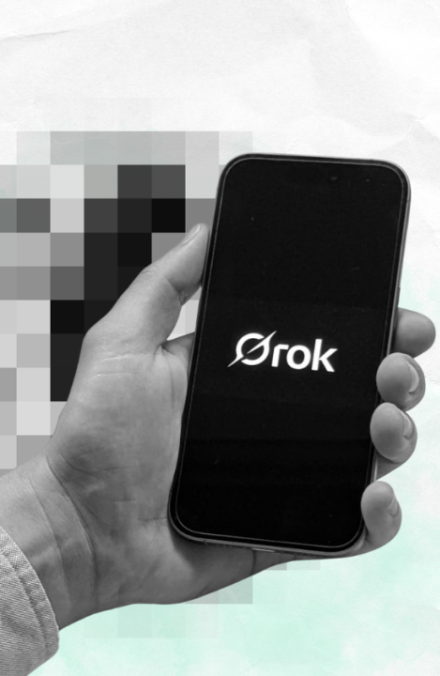
EVIDENCE OF GENDERED HARM ON AI:
Grok floods X with sexualised images of women and children

Slide 6
Trigger Warning: Violence
In the next three slides, we will be introducing our recent research on
how Grok (X’s AI) enabled the generation of sexualised images.
Feel free to leave the room if you start feeling uncomfortable.

Slide 7
Online GBV Is Part of the Continuum of Violence
Online gender-based violence is not a separate phenomenon — it is part of the continuum of violence women experience offline
The digital sphere creates new and more complex ways to perpetrate abuse
Millions of women across Europe experience digitally facilitated violence, while perpetrators often face little accountability
In Europe, 9 million girls have experienced some form of online violence by the age of 15
Women and girls have the right to live free from violence in every aspect of their lives — including online

Slide 8



ONLINE SAFETY ACT
UK Government recognised risk from online harms and social media companies’ failings
Online Safety Bill sought to address them, becoming law in 2023
Now the Online Safety Act, the law requires social media companies and search engines to:
Identify and remove illegal content
Protect children from encountering harmful content online
Give adults more choice over what they see online

Slide 9
GROK AND THE RAPID SPREAD OF SEXUALISED AI IMAGES
X’s AI image-editing tool Grok was rapidly used to generate and distribute sexualised images at an unprecedented scale after launching in late December.
In just 11 days…
3 million photorealistic sexualised images were created and shared
= 190 images per minute on average
Women and girls were targeted:
23,000 sexualised depictions of children (including school-aged girls and child actors)
Estimate 1.8 million were sexualised images of women

Slide 10
WHAT THIS MEANS FOR WOMEN AND GIRLS’ SAFETY
Harm at scale: AI can rapidly generate harm to women and girls
Regulation gap: OSA covers X, but launched without effective preventive safeguards
Reactive, not preventive: Ofcom and the UK Government raised concerns, but action came after the harm occurred

Slide 11
THIS IS NOT AN ACCIDENT BUT INTENTIONAL DESIGN OUTCOME
Lack of safety-by-design in new technology products
Who should be held accountable for this?

Slide 12

DISCUSSION
When AI systematically sexualise women and girls at scale, who should be held responsible and what does accountability actually look like?

Slide 13
DISCUSSION
What is being prioritised over safety when AI that sexualise women and girls are deployed at scale?
At what point safety needs to be implemented in the design?
How can we make it happen? Who has the power to do that?

Slide 14

Key Takeaways &
Next Steps

Slide 15
KEY TAKEAWAYS
AI failure is a design failure
Gender harm is predictable and preventable, if people choose safety over profit
We must push the government and regulators for faster investigation and implementation of a lot better online safety for us

Slide 16
ADVOCATE FOR CHANGE
CCDH’s STAR Framework
S
T
A
R
Safety by design
Transparency of algorithms,
rules enforcement + economics
Accountability to democratic bodies
Responsibility of platforms
+ their senior executives

Slide 17

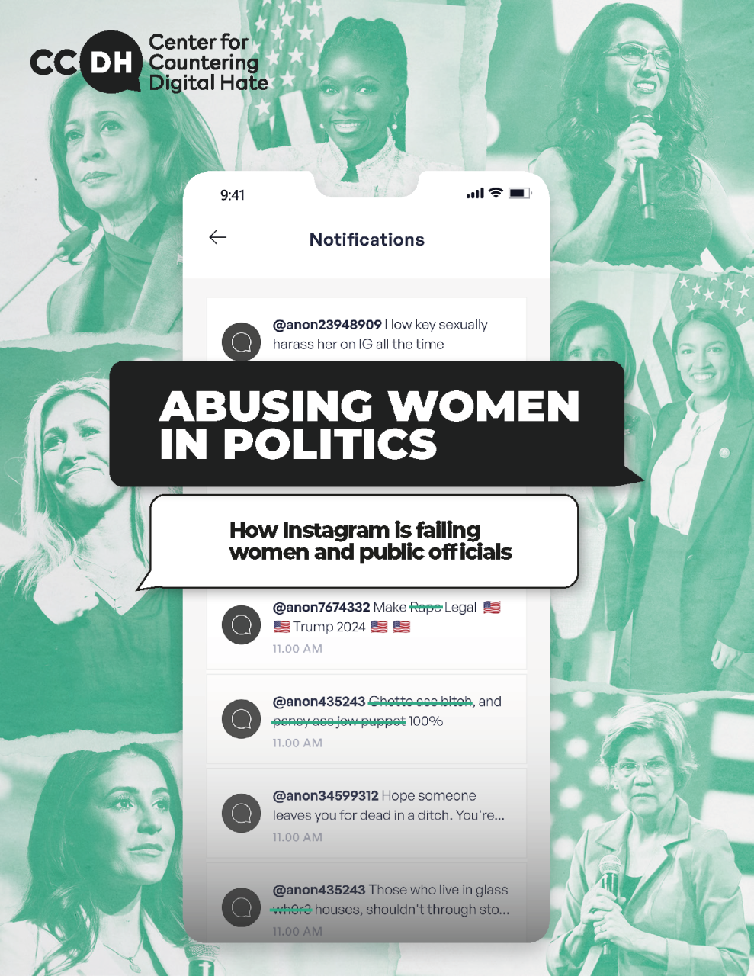
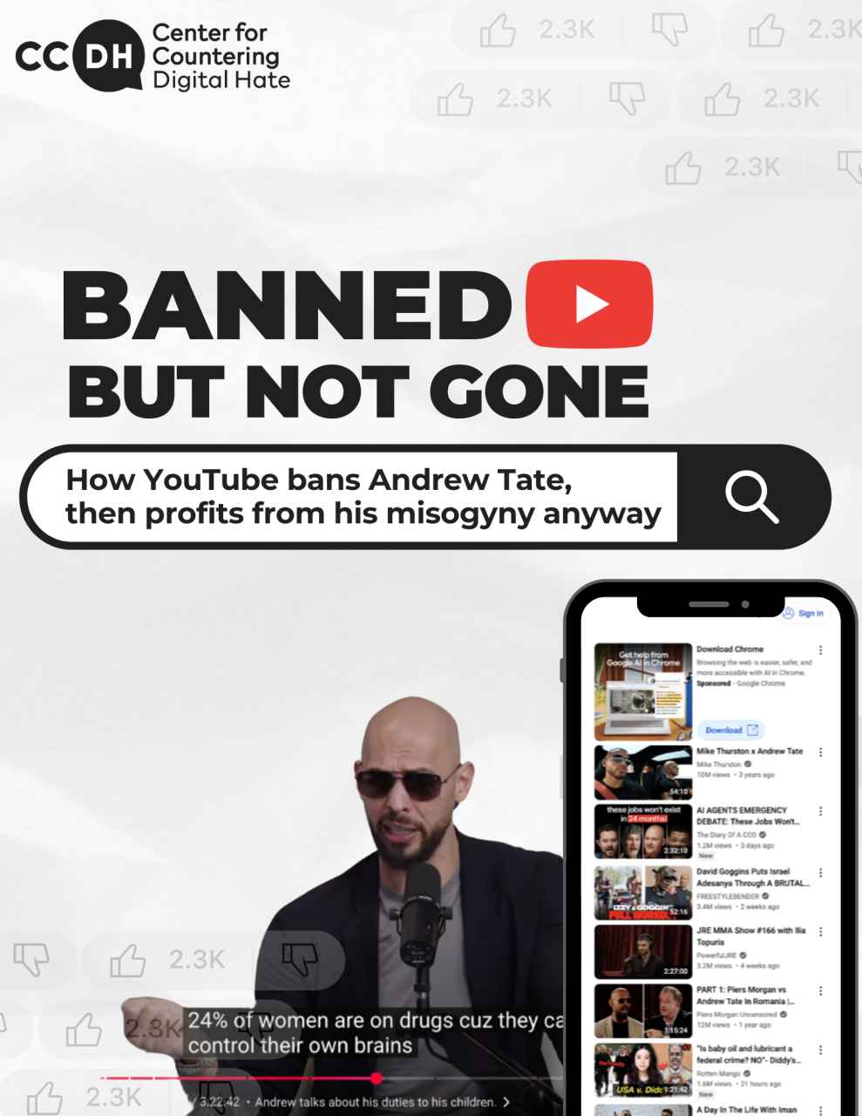

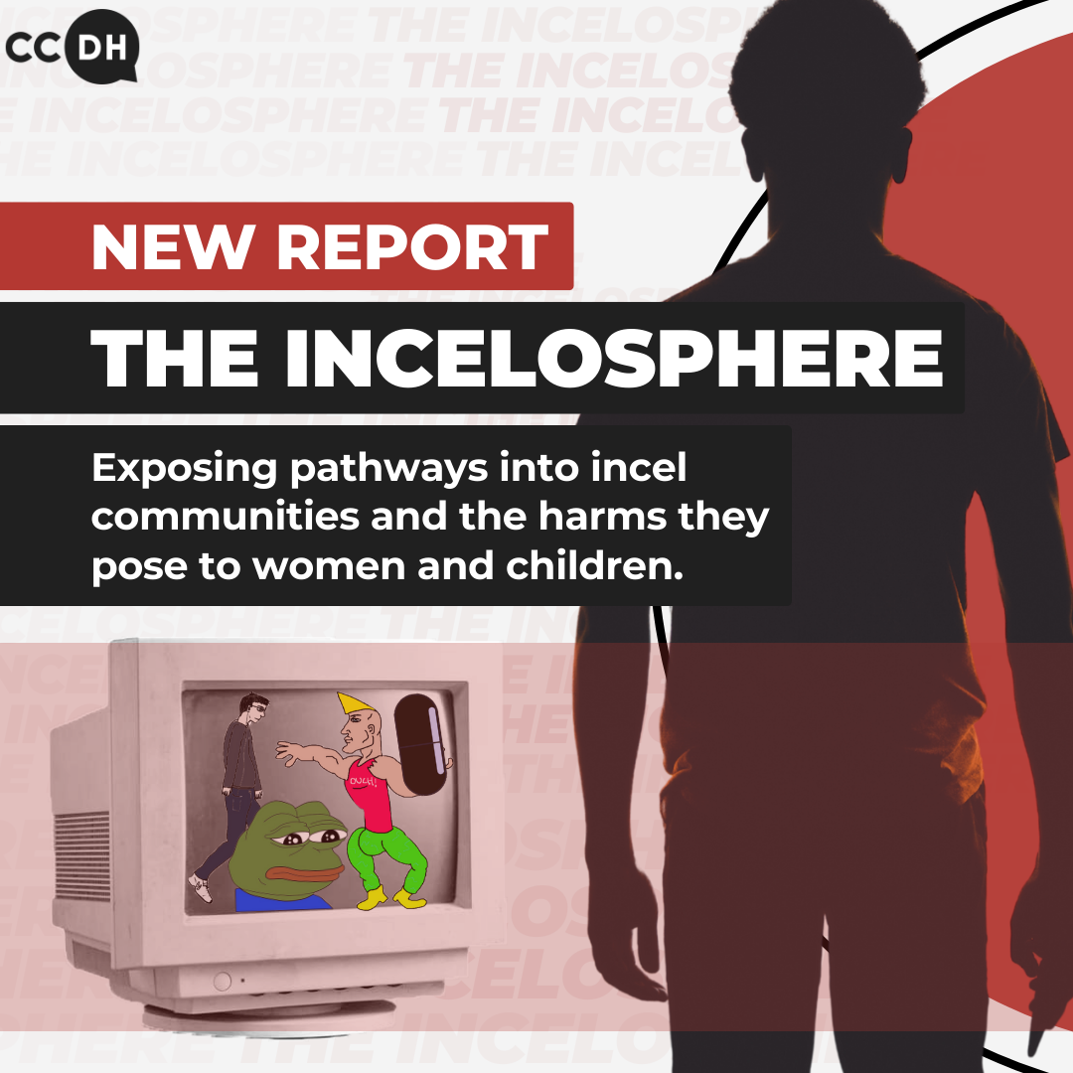
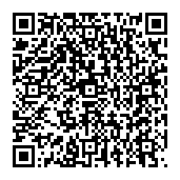
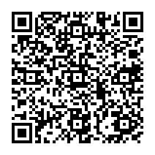
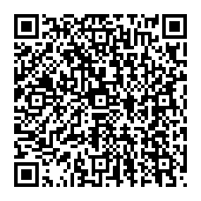
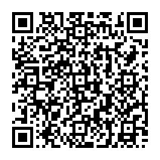
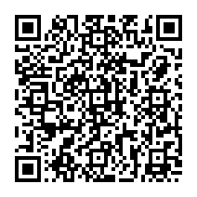
READ OUR REPORTS
AI
Misogyny
SRHR

Slide 18
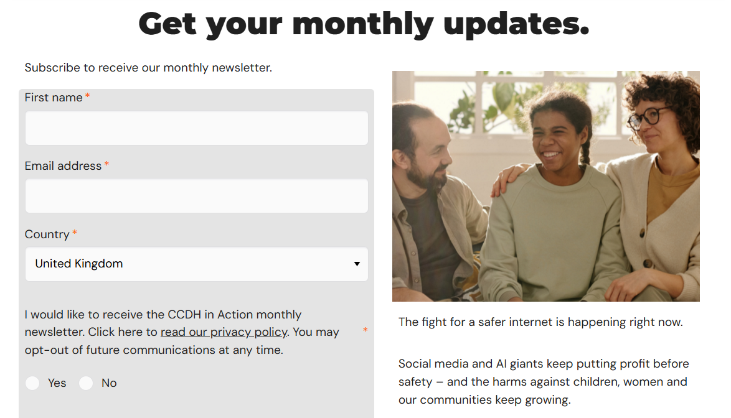
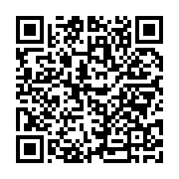
SIGN UP FOR OUR NEWSLETTER

Slide 19
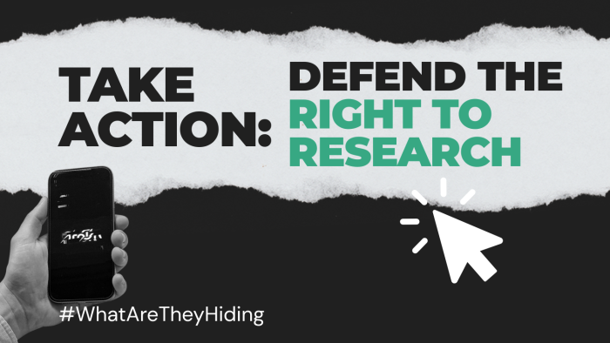
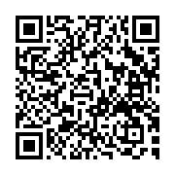
SIGN OUR PETITION

Slide 20
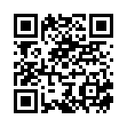
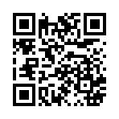
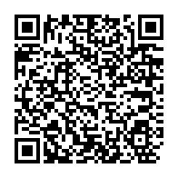
FOLLOW US ON SOCIAL MEDIA
Bluesky
Instagram
LinkedIn

