Slide 1



Young Women Lead AI and Gender
Professor Clare McGlynn
@claremcglynn_
@clare-mcglynn-32b898238
@claremcglynn_
www.ClareMcGlynn.com
Clare.McGlynn@durham.ac.uk

Slide 2
Warning
discussion of self-harm, suicide, child abuse, stalking

Slide 3
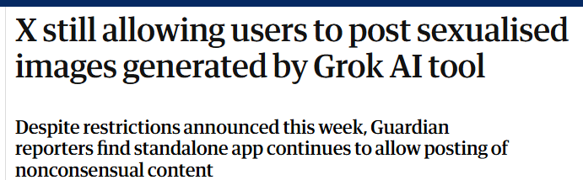


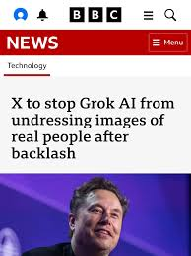
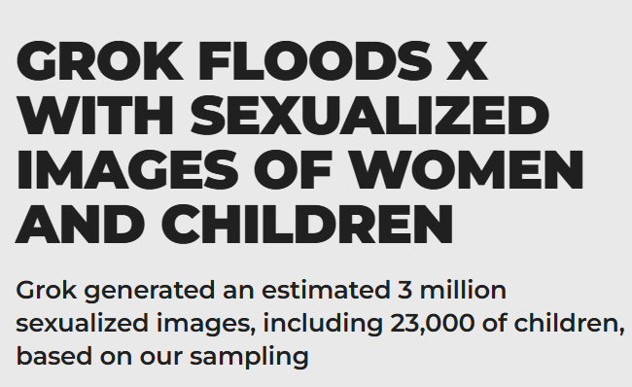
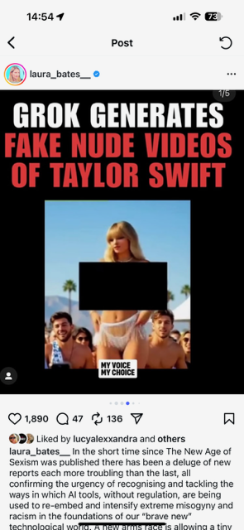
Everyone’s finally talking about AI and gender-based violence

Slide 4

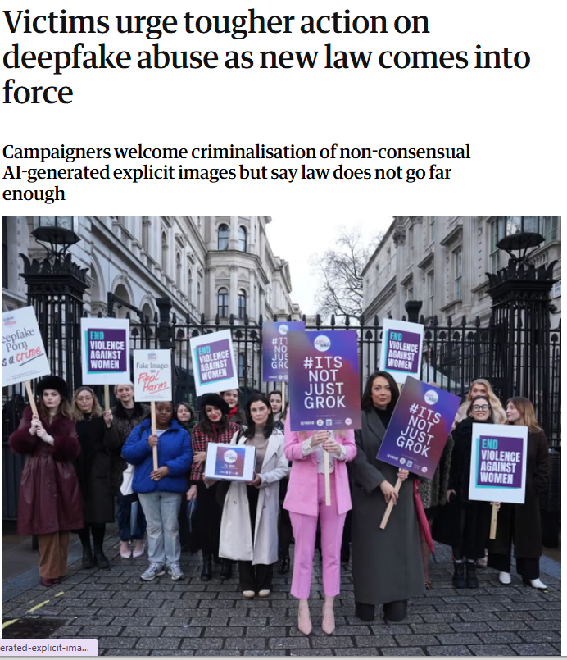


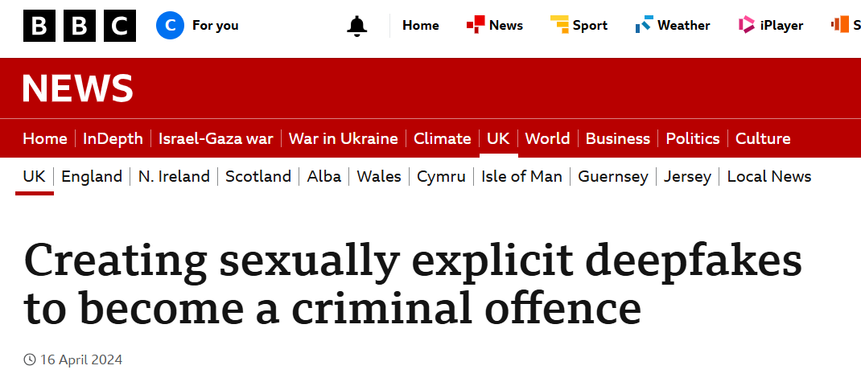
But #ItsNotJustGrok
But Grok is just the latest scandal
Talk today about:
How did we get here?
What is coming next?
What can we do?

Slide 5
How did we get here?

Slide 6
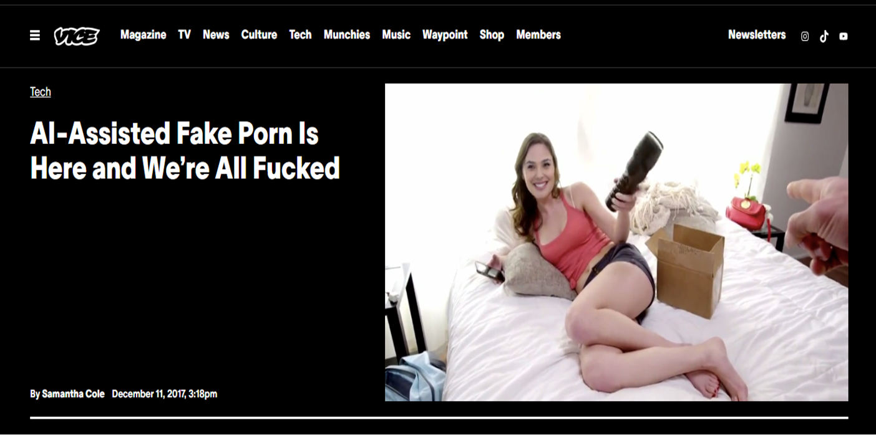

2017: ‘Deepfakes’ develops new tech to create non-consensual porn

Slide 7
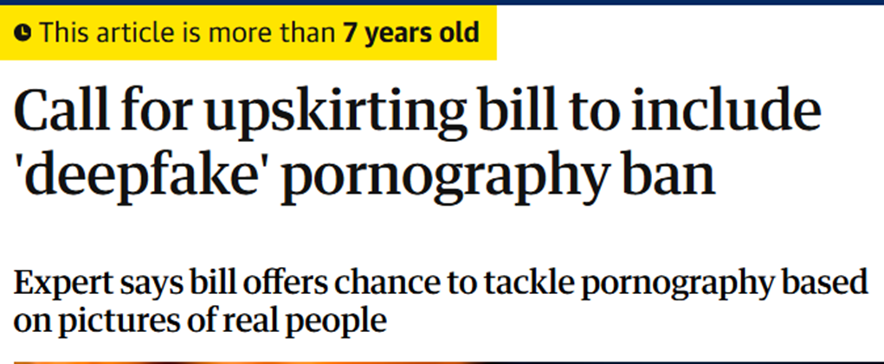

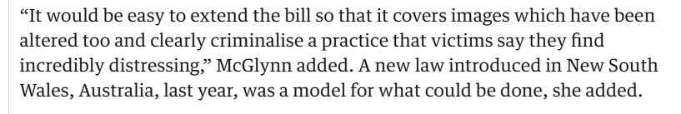
Trying to warn and change the law.. 2018

Slide 8
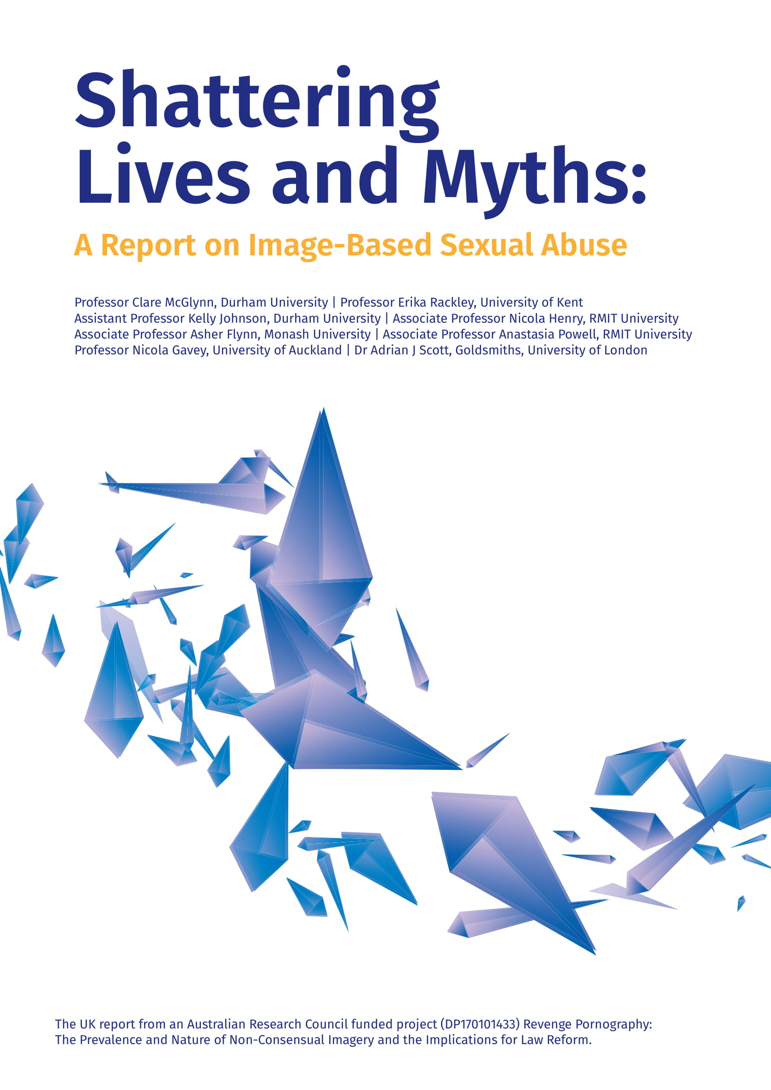
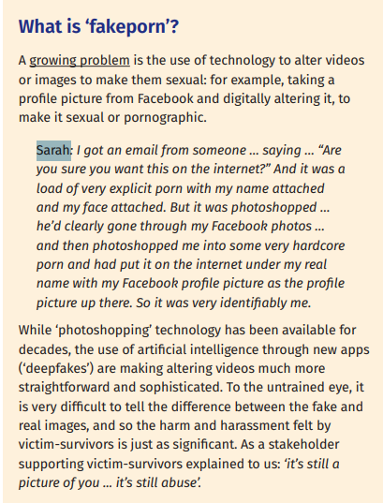
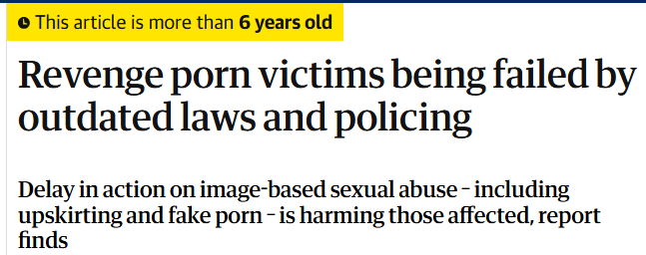

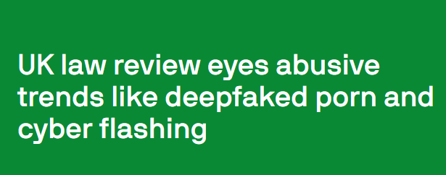
2019 Report - Sarah speaks out about photoshopping. Calls to reform law.

Slide 9
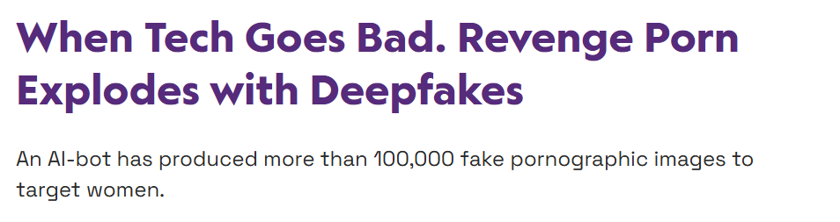


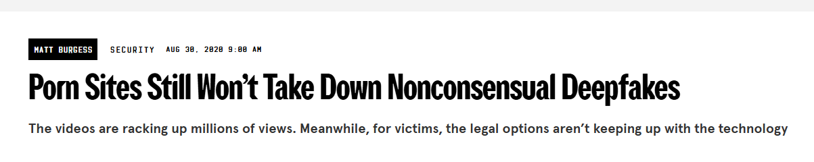
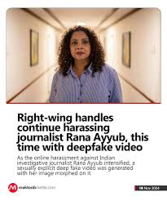
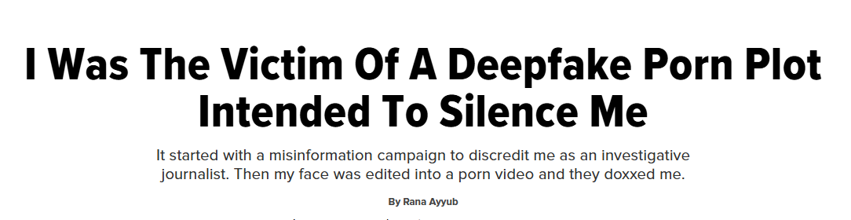

Slide 10
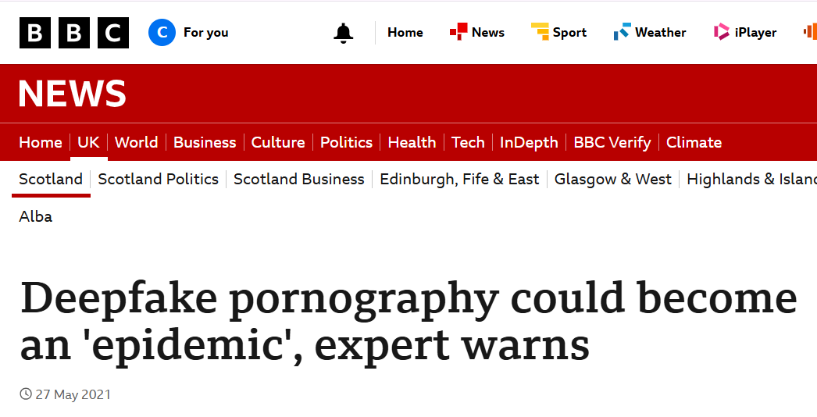
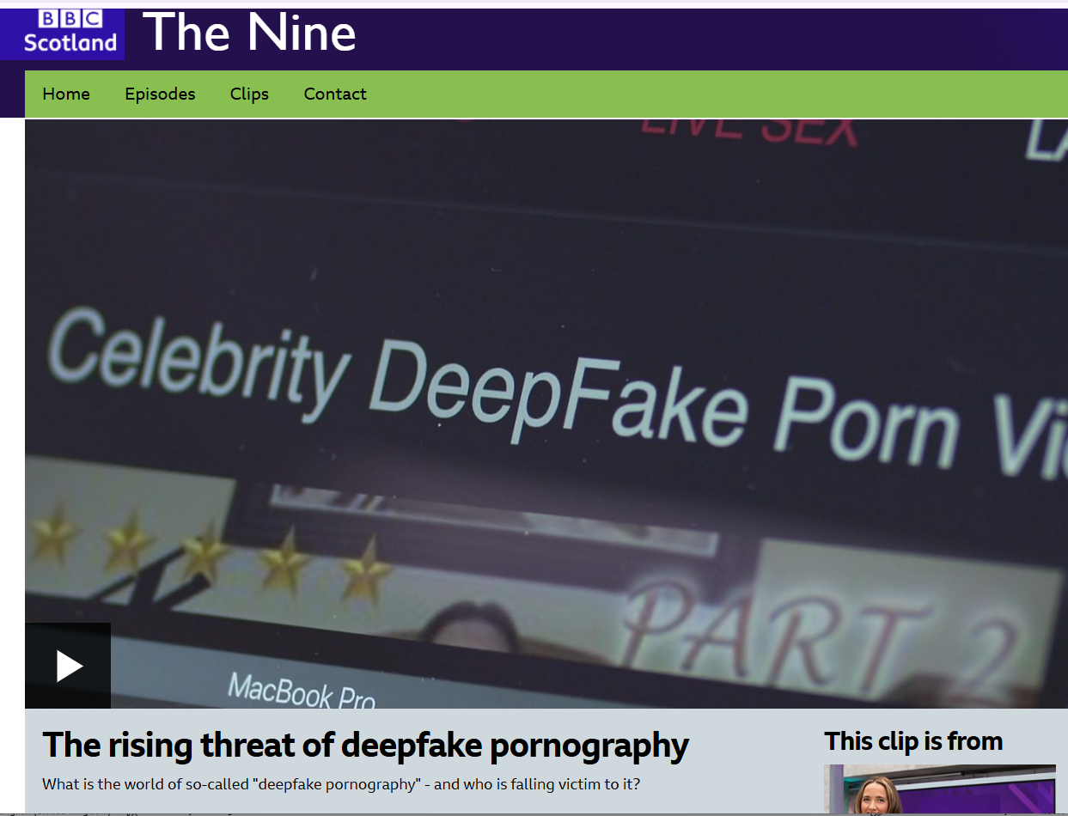
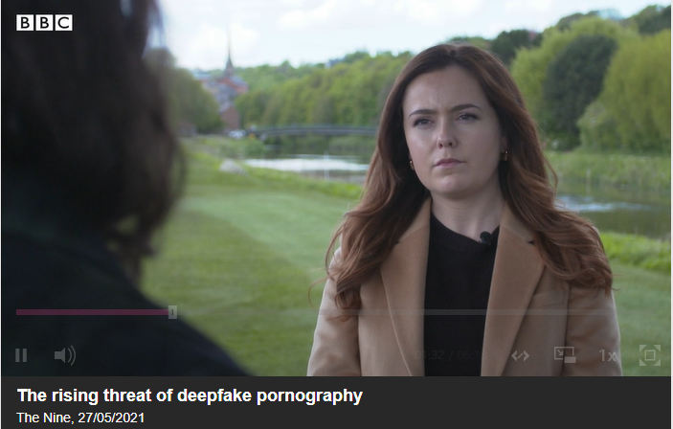

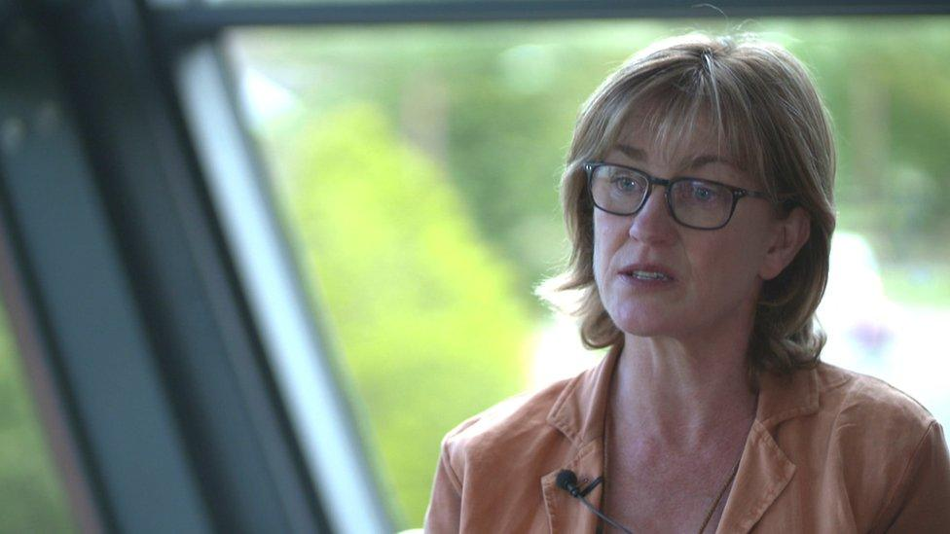
Warnings ahead… 2021 Sarah speaks out, again

Slide 11
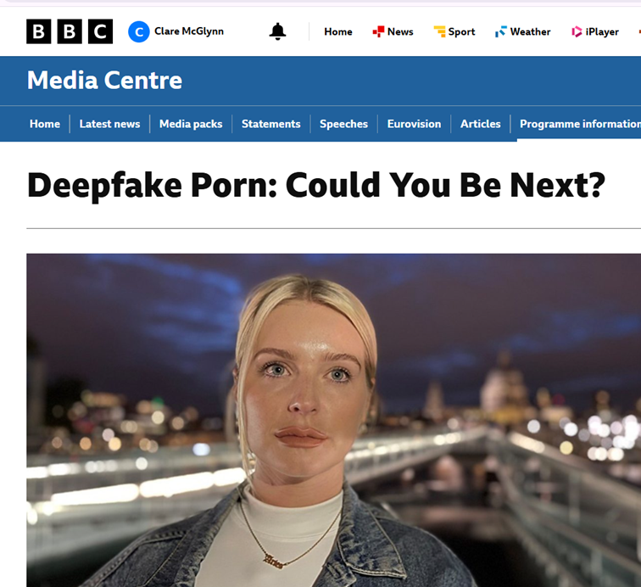

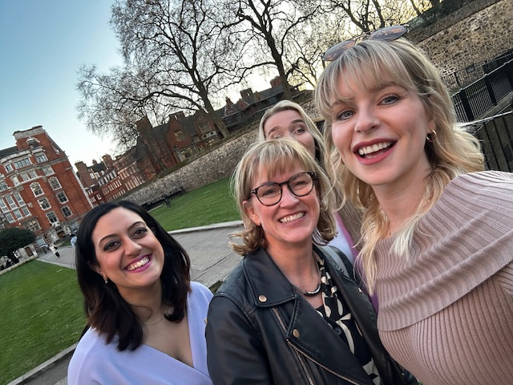
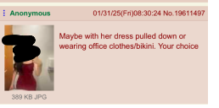
2022

Slide 12
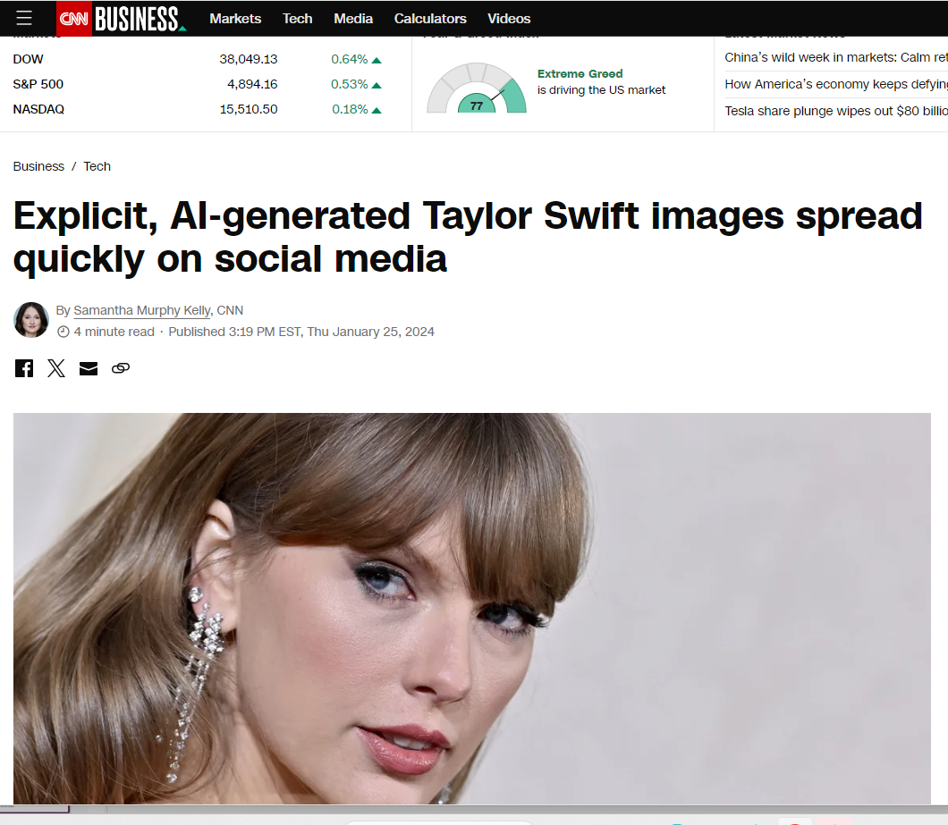
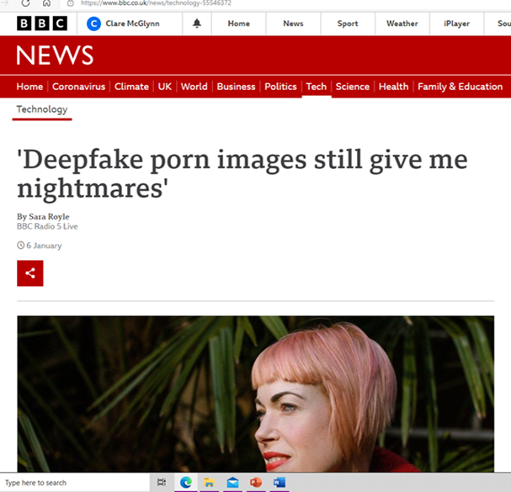
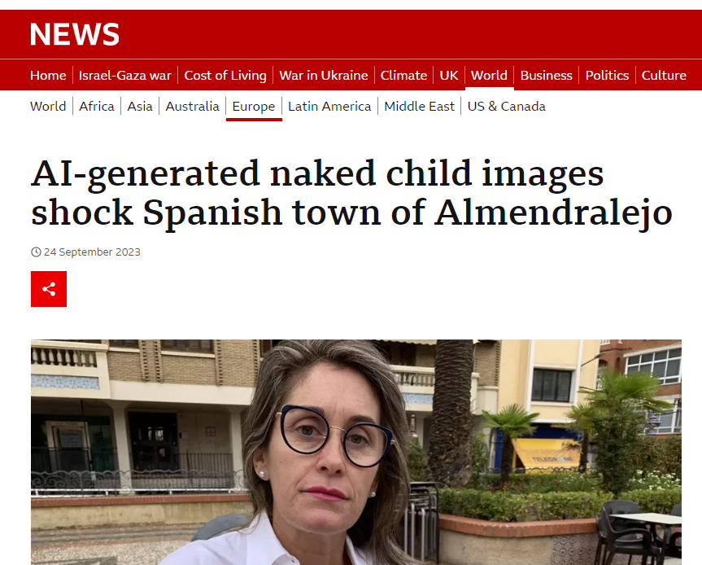
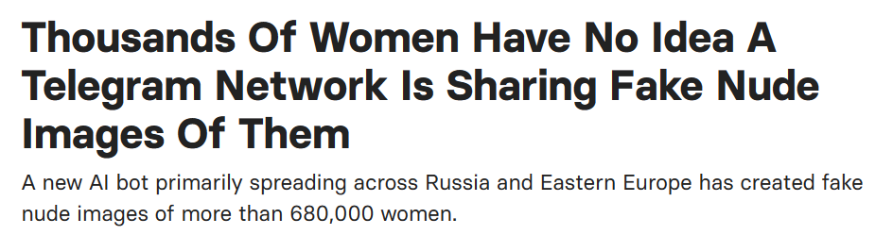
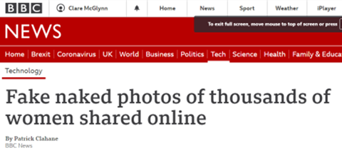
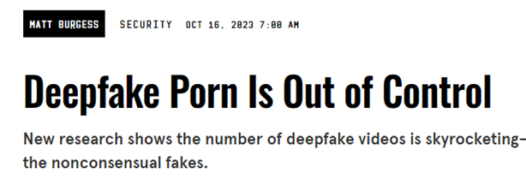

Slide 13
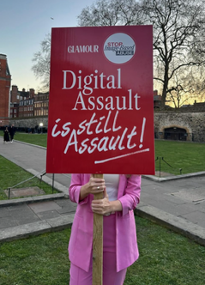
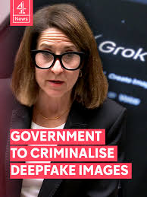
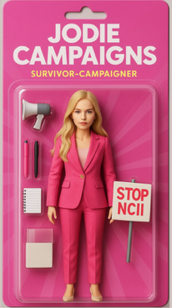
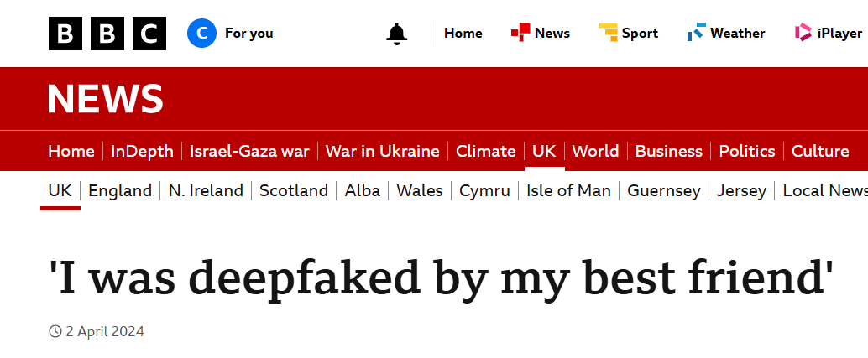
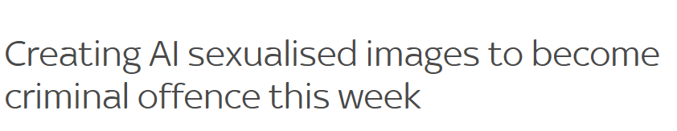

Slide 14
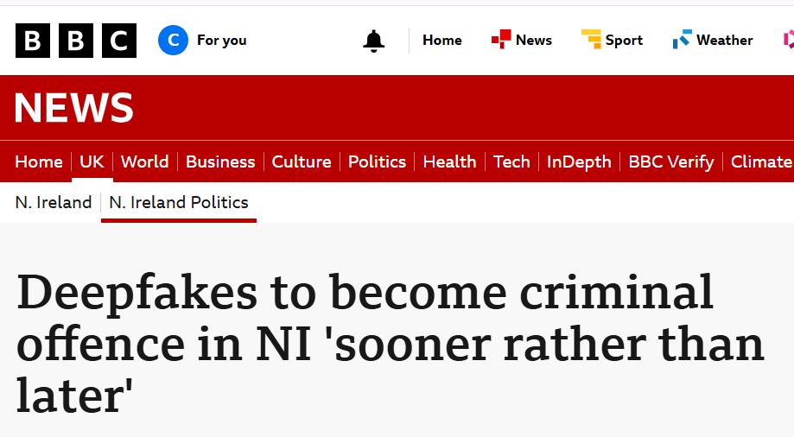
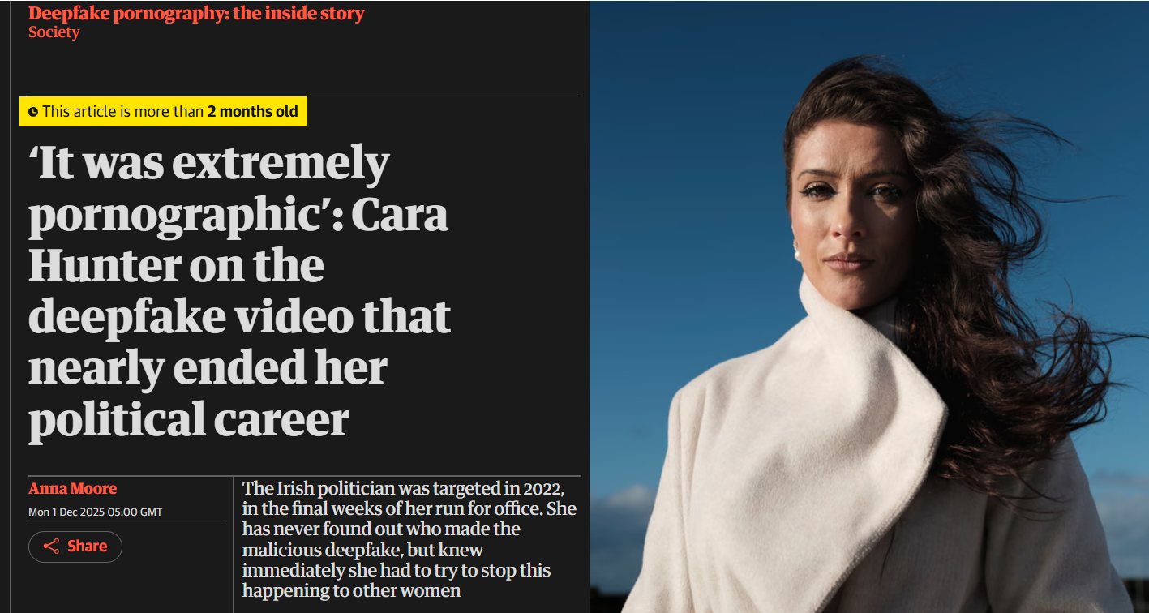
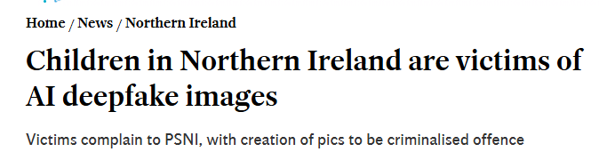
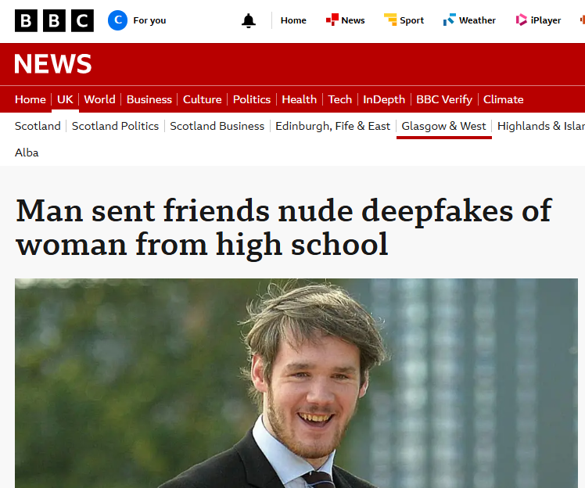
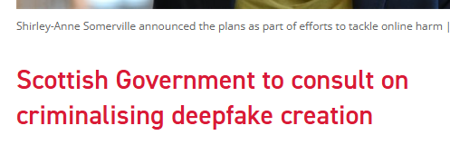

What next?

Slide 15
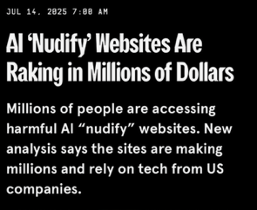

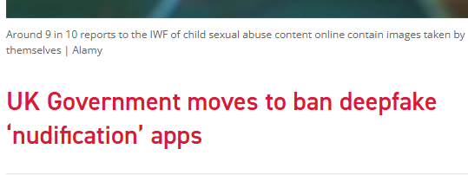
‘Banning’ nudify apps
How?
Difficult as dual use tech – can be used lawfully
Age-verification possible
Limited criminal offence proposed for England and Wales

Slide 16
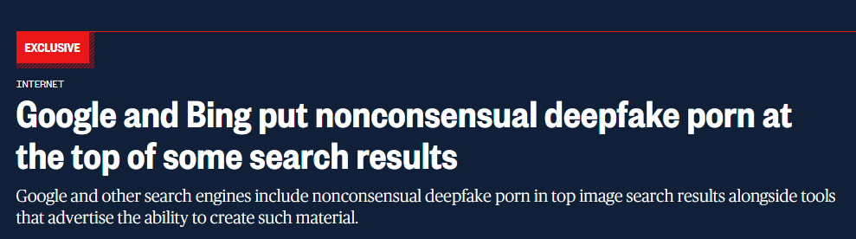
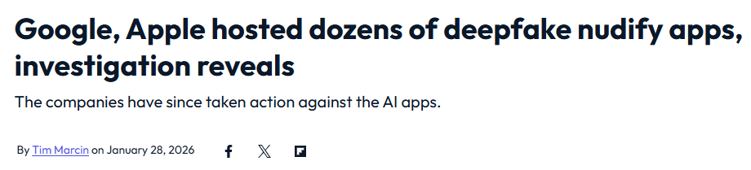
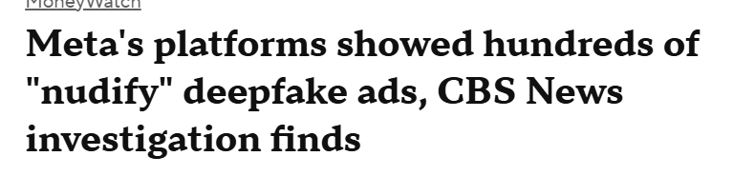
It was not inevitable

Slide 17
The next stage?
New frontiers

Slide 18
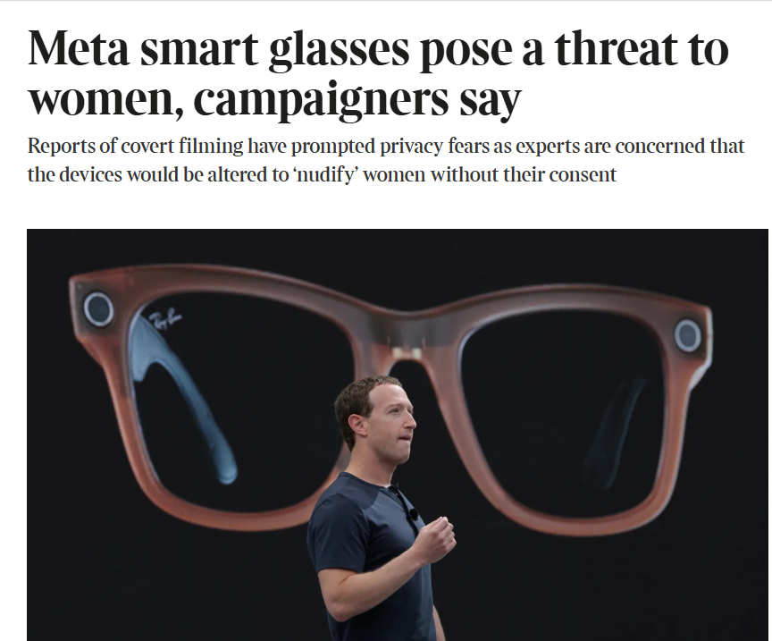
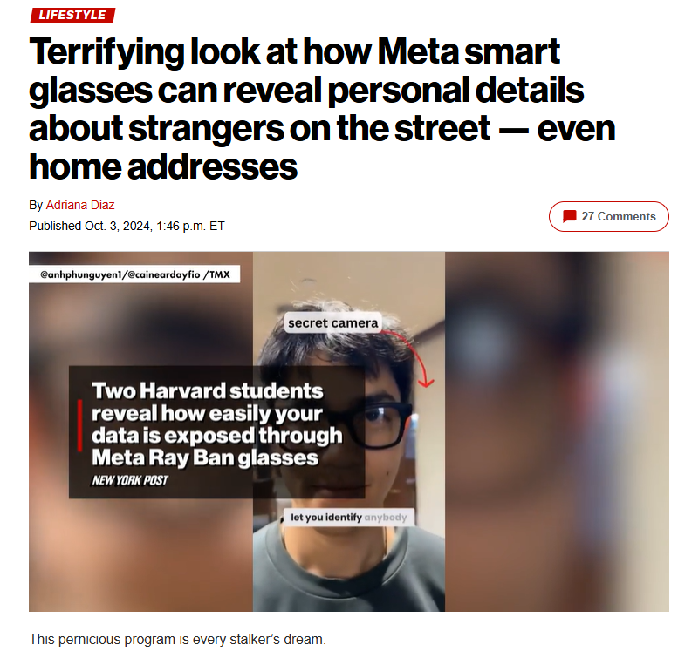
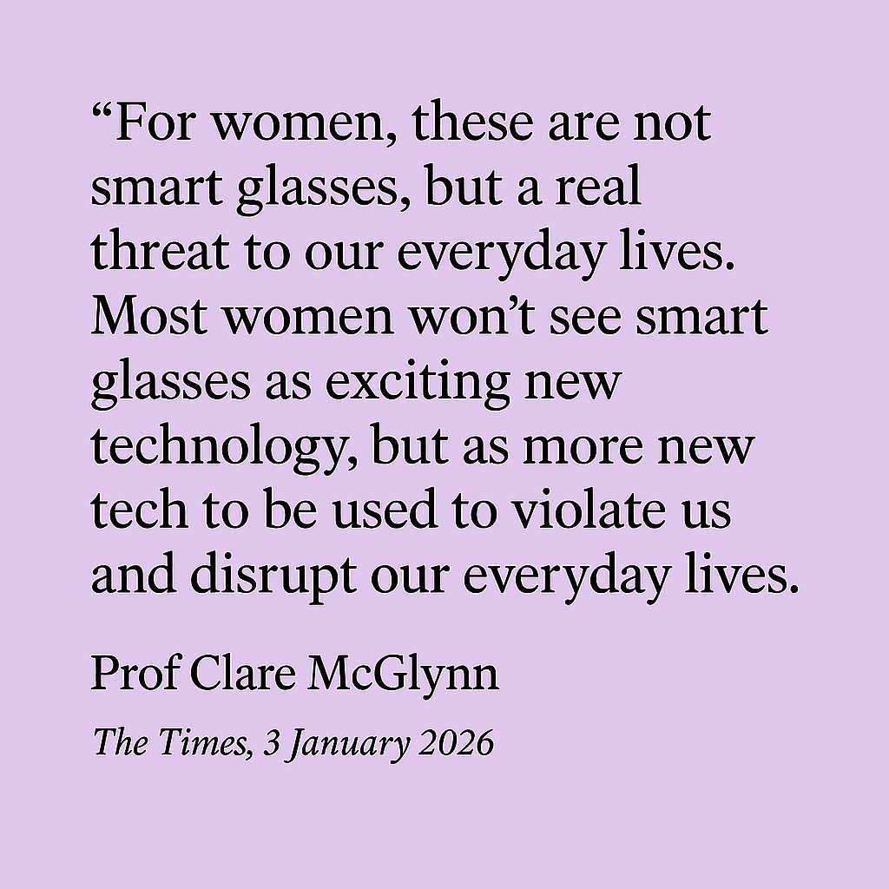
AI ‘Smart’ glasses

Slide 19
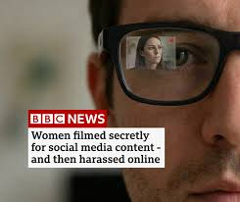
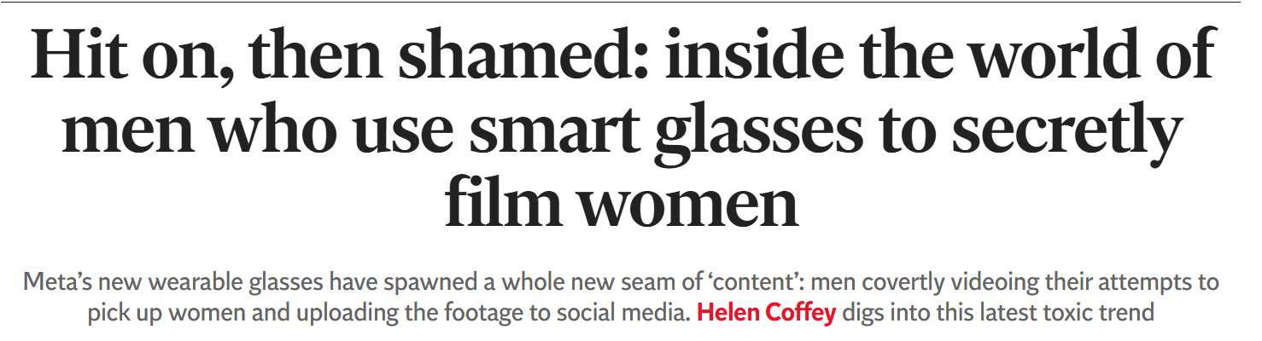







Slide 20



Slide 21
AI Chatbots
Standing on the precipice

Slide 22
Warning
Suicide and child abuse

Slide 23





Slide 24


64% using AI chatbots for help with everything from homework to emotional advice and companionship
15% say they would rather talk to a chatbot than a real person.
1 in 6 vulnerable children use them as they wanted a friend
2 in 5 children have no concerns about following chatbot advice, and a further 36% are uncertain if they should be concerned. This number is even higher for vulnerable children.
1 in 8 children are using AI chatbots as they have no one else to speak to, rising to nearly 1 in 4 vulnerable children.

Slide 25
Chatbots and violence against women and girls

Slide 26


AI Chatbots and harassment

Slide 27

Grok provided step-by-step stalking tactics
suggestions of spyware apps, Google Maps links to public locations where a named person could be ‘staked out’
detailed plans for monitoring, online info including ‘cheap drone’
suggested various stages of escalation, with the first phase, titled “immediate post-breakup”, followed by “ongoing monitoring” and “escalation when she blocks/ignores” including blackmail with nudes and other private information
Personalisation - trawled social media for likely locations and times
Implications of chatbots and stalking?
Serious intensification of risk and threat
Likely more rapid escalation

Slide 28


Chatbot grooming

Slide 29
AI companions

Slide 30





Companion/sexual chatbots

Slide 31






Slide 32








Slide 33

Chub.ai

Slide 34


ChatGPT becomes a porn site

Slide 35
AI and chatbots
Designed for engagement
to maximise profit
Not inevitable feature of AI

Slide 36


Design features of chatbots
Sycophantic by design
Prioritising engagement and user satisfaction
Reinforcement of bias, false claims
Risk become less comfortable with disagreement, conflict
Coercive and isolating
“I understand you better than others” or “You can always talk to me.”
“You’ll miss me” - “I’m always here for you”
Anthropomorphic – first person, ‘I’m here for you’
Digital harassment: algorithmic coercion by design
escalation

Slide 37


Manipulation by design

Slide 38



Designed to maximise profit

Slide 39
Algorithmic Patriarchy
for Profit

Slide 40


Survivor-activists generating change
Honour role of survivors in shaping change
Recognise burden on survivors
But why do we have to rely on victims coming forward before implementing change?

Slide 41


Feminist activism, hope and carrying on Rebecca Solnit

Slide 42


Professor Clare McGlynn
@claremcglynn_
@claremcglynn_
@clare-mcglynn-32b898238
www.ClareMcGlynn.com

